Slide 1
Project Topic: EzCamp(camp house book app)
CSYE 7280 – FINAL PROJECT
ZICHUN WANG

Slide 2
Journey

Slide 3

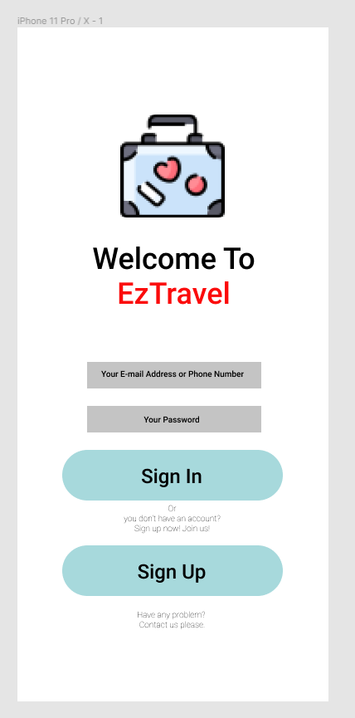
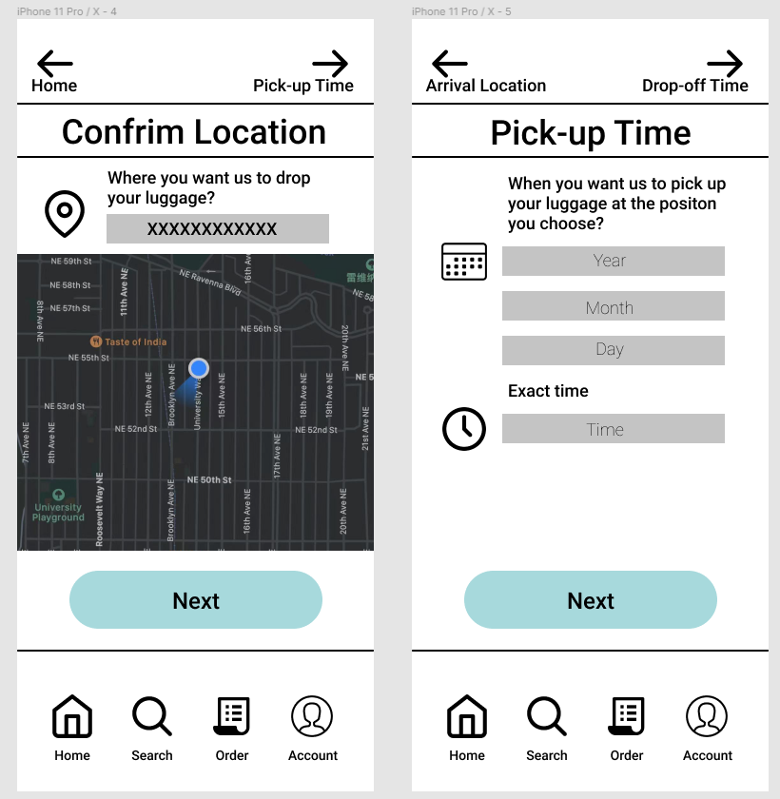
Journey
The beginning of the EzCamp
At the beginning of the class, I decided to design an app which can help people who will travel a long distance and carry a lot of heavy and big luggage.

Slide 4
Journey
The beginning of the EzCamp
Change Design Topic
At first, I thought it was easy to design a protopyte of this app. But I found
I was wrong about this. It was more difficult than I thought.
Accidentally, I discussed this app with one of friend. And he adviced me to change the topic. He loved going camping with his friends. He said he was always worried about where to find a camp house to get over night.
So I decided to change my topic.

Slide 5
Journey
Preparation
If I want to design an app for campers. I need to know what are their request and problems.
So I disscussed with my friend about which problem will he face and what can I do to help him have a better camping experience.
According to his problem, I re-design my storyboard.

Slide 6
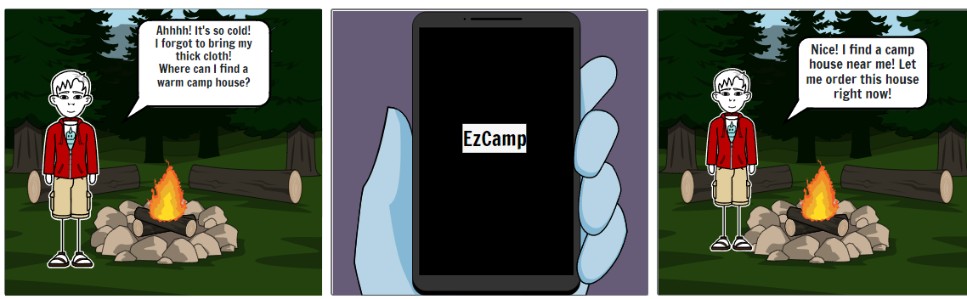
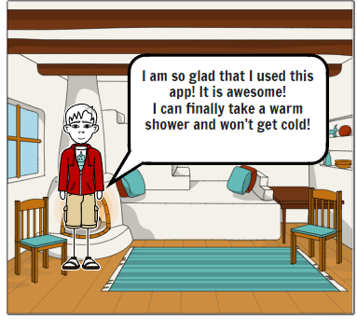
Journey
Storyboard

Slide 7
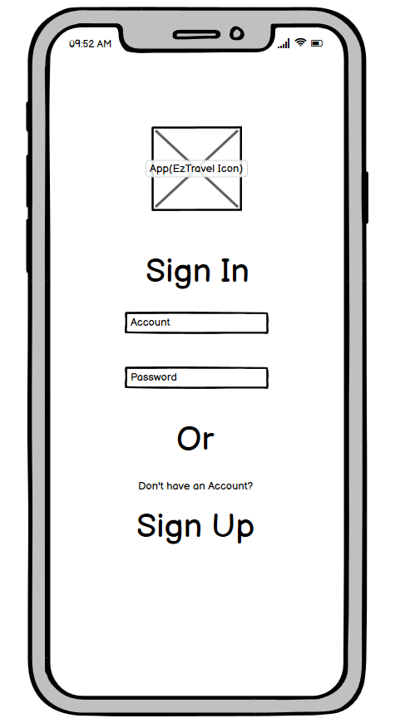
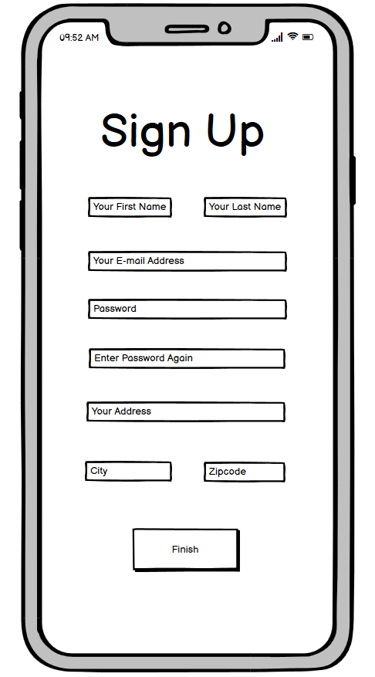
Journey
Lo-Fi wireframe
After designning the storyboard, I need to design a lo-fi wireframe which
should include all the basic functions, including login, sign up, order, account setting, GPS and collection.

Slide 8
Journey
Hi-Fi wireframe
After the Lo-Fi wireframe, I need to turn my Lo-Fi wireframe into Hi-Fi wireframe. There are bunch of things I need to consider, which are theme colour, the button shape, the layout. I must consider every aspect, so that I can offer users a good using experience. And I need to help them find the camp house as fast as possible, so they will avoid the danger of wildlife, the cold weather.

Slide 9
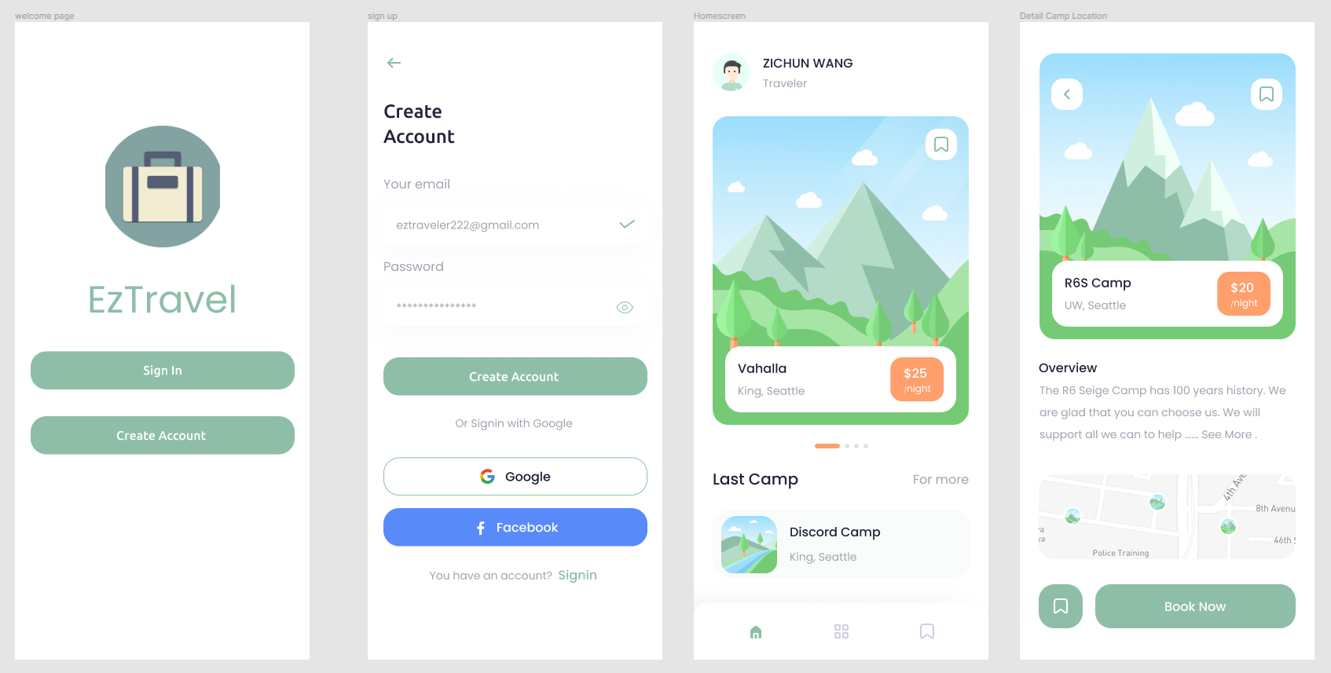
Journey
Hi-Fi wireframe

Slide 10
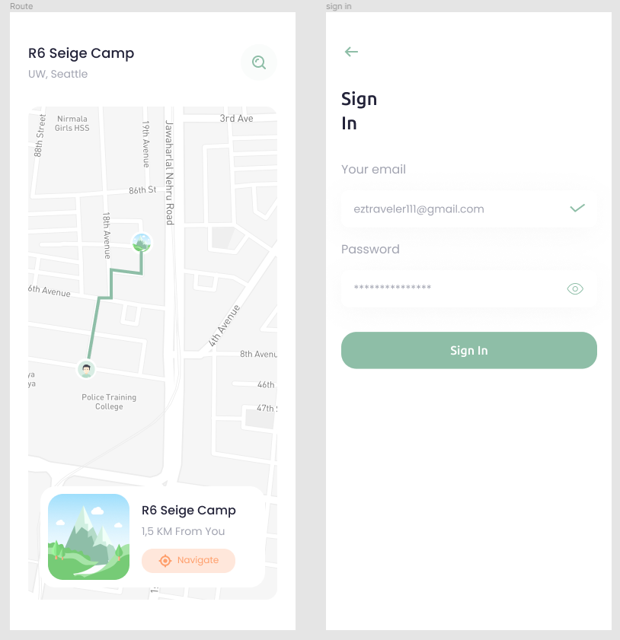
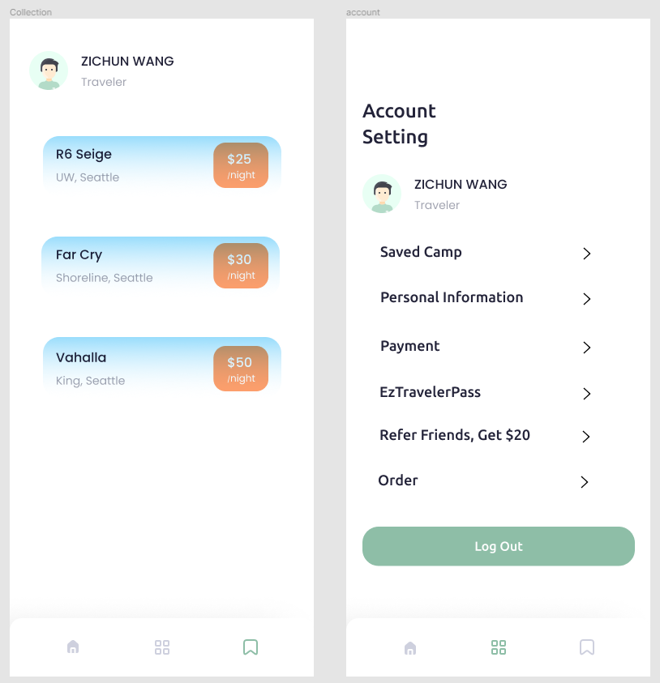
Journey
Hi-Fi wireframe

Slide 11
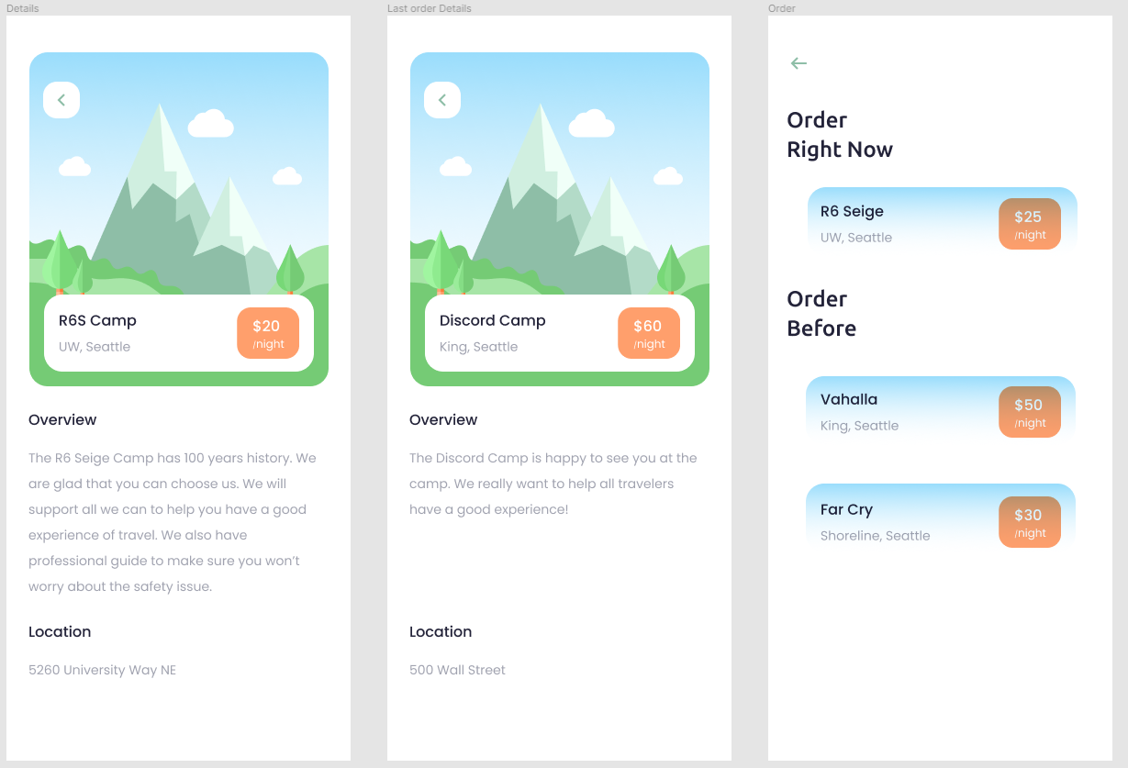
Journey
Hi-Fi wireframe

Slide 12
Journey
Hi-Fi wireframe

Slide 13
Journey
User Testing
I used UserTesting website to invite 2 real users to test my prototype. And they gave me a lot of advises. And according to their response, I finished my user testing report.
Recommendation from Users
I used UserTesting website to invite 2 real users to test my prototype. And they gave me a lot of advises. And according to their response, I finished my user testing report.
1. add a filter which can filter results users like
2. switch the camp imagine to real camp house photo
3. the home page button should be able to be swapped, so that the users can view more options of camp house
4. the 3 buttons(home page, collection, account setting) at the bottom of screen should switch positions

Slide 14
Journey
Improvement
I listened carefully to users’ advices, and made some improvement to my app.
1. I made my home be able to be swapped
2. I changed my word size and word type, so that this app could make users have a better using experience.

Slide 15
Conclusion

Slide 16
Conclusion
Conclusion
This lesson is so interesting. Prof let me know how can I design an app which could make users feel relax when using my app.
I must consider every aspects of my app. Every tiny thing could make the app better or worse.
The app is not perfect, I believe in the future I will make it better. Maybe in 10 years, it will come into the market. lol
I want to thank every classmate and prof for helping me design the app.

Slide 17
THANK YOU !

